Slide 1
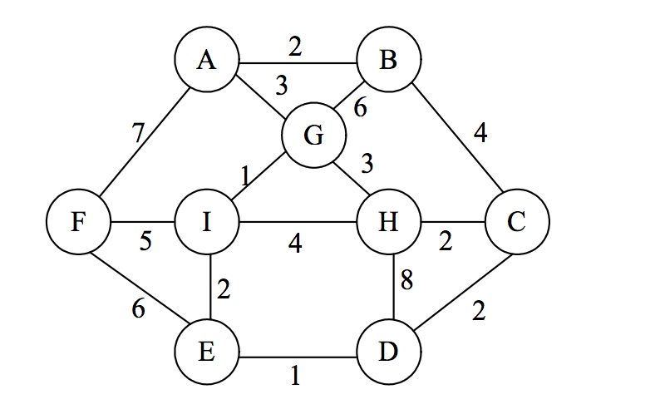
Virtual Tourist's Guide
Tourist’s Map Simulator

Slide 2
Executive Summary:
Importance of this simulator.
Problem.
Proposed solution.
Software description and facilities.
Key of the project.

Slide 3
Executive Summary:
Running platform.
Risks of this software.
Goals of this software.

Slide 4
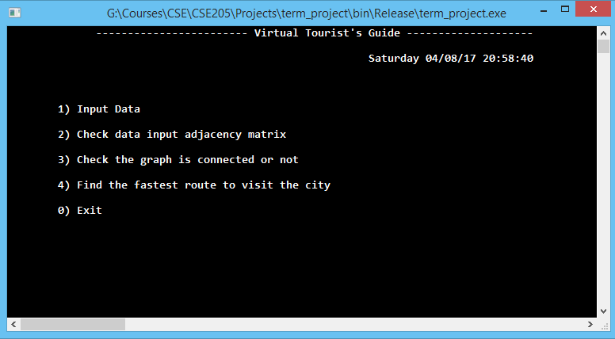
Project Ideas and Layouts
Using Interface

Slide 5


Project Ideas and Layouts
1) Input Data
1) Input Data Manually
2) Input Data From File
3) Random Input Data
0) Return To Main Menu
2) Check data input as adjacency matrix
3) Check the graph is connected or not
1) Find Minimum cost from a source to visit all cities.
2) Find the shortest path from source to destination with minimum cost.
0) Exit
Output adjacency matrix
Output Graph is Connected or not.
Terminate Program
Input from keyboard
Input from project Root file
Generate Random Graph
4) Find the fastest route to visit the city
0) Return to main Menu.
Return To Main Menu
Return To main Menu
Using Travelling Salesman (Back-Tracking) algorithm and print the minimum cost from source to destination.
Using Travelling Salesman (Back-Tracking) algorithm and print the minimum cost
with direction from source.
To generate random complete
graph, using Iterative
Permutation process.
Using Breadth-first
Search.

Slide 6
Algorithms and software description
Main algorithms:
Generate random graph (Iterative permutation methods [O(n ²)])
Check the graph is connected or not (Breadth-first search [O(N+E)])
Calculate the minimum cost (Travelling salesman- Backtracking [O(n!))

Slide 7
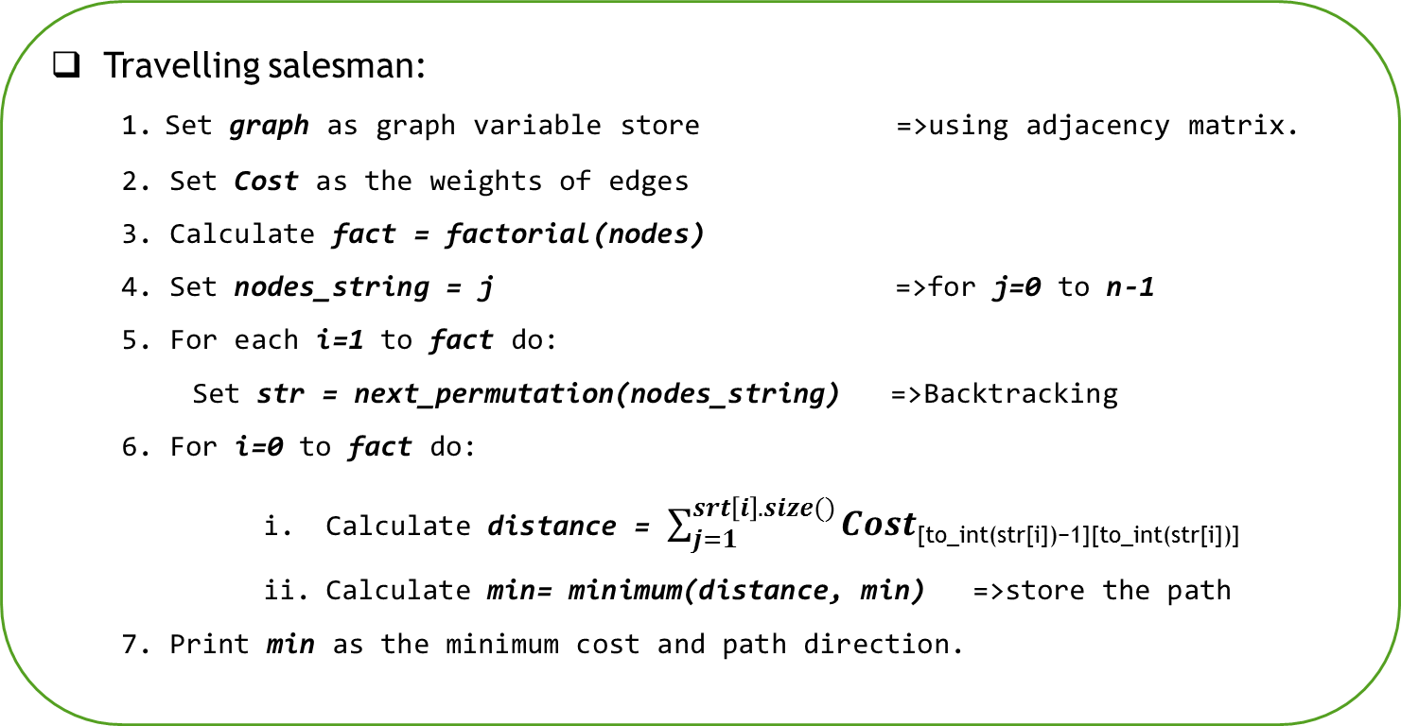
Algorithms and software description
Travelling salesman:
1. Set graph as graph variable store =>using adjacency matrix.
2. Set Cost as the weights of edges
3. Calculate fact = factorial(nodes)
4. Set nodes_string = j =>for j=0 to n-1
5. For each i=1 to fact do:
Set str = next_permutation(nodes_string) =>Backtracking
6. For i=0 to fact do:
Calculate distance = $\sum_{j=1}^{srt\left[i\right].size()}{Cost\text{[}\text{to}\text{_}\text{int}\text{(}\text{str}\text{[}\text{i}\text{])−1][}\text{to}\text{_}\text{int}\text{(}\text{str}\text{[}\text{i}\text{])]}}$
Calculate min= minimum(distance, min) =>store the path
7. Print min as the minimum cost and path direction.

Slide 8

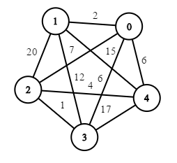
Algorithms and software description
Simulation:
Number of nodes
Inputs:
5 10
0 1 2
0 2 7
0 3 6
0 4 6
1 2 20
1 3 12
1 4 15
2 3 1
2 4 4
3 4 17
Number of edges

Slide 9
Algorithms and software description
Simulation:
All possible permutations for source 0
0 => 1 => 2 => 4 => 3 = 43
0 => 1 => 3 => 2 => 4 = 19
0 => 1 => 3 => 4 => 2 = 35
0 => 1 => 4 => 2 => 3 = 22
0 => 1 => 4 => 3 => 2 = 35
0 => 2 => 1 => 3 => 4 = 56
0 => 2 => 1 => 4 => 3 = 59
0 => 2 => 3 => 1 => 4 = 35
0 => 2 => 3 => 4 => 1 = 40
0 => 2 => 4 => 1 => 3 = 38
0 => 2 => 4 => 3 => 1 = 40
0 => 3 => 1 => 2 => 4 = 42
0 => 3 => 2 => 1 => 4 = 42
0 => 3 => 2 => 4 => 1 = 26
0 => 3 => 4 => 1 => 2 = 58
0 => 3 => 4 => 2 => 1 = 47
0 => 4 => 1 => 2 => 3 = 42
0 => 4 => 1 => 3 => 2 = 34
0 => 4 => 2 => 1 => 3 = 42
0 => 4 => 2 => 3 => 1 = 23
0 => 4 => 3 => 1 => 2 = 55
0 => 4 => 3 => 2 => 1 = 44
0 => 1 => 2 => 3 => 4 = 40
0 => 3 => 1 => 4 => 2 = 37
Minimum Cost: 19
Path: 0 => 1 => 3 => 2 => 4

Slide 10
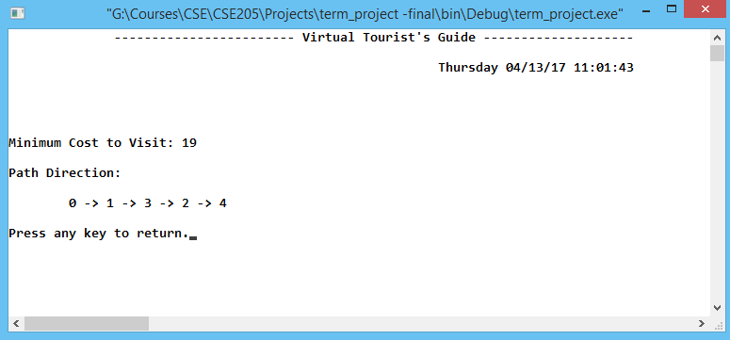
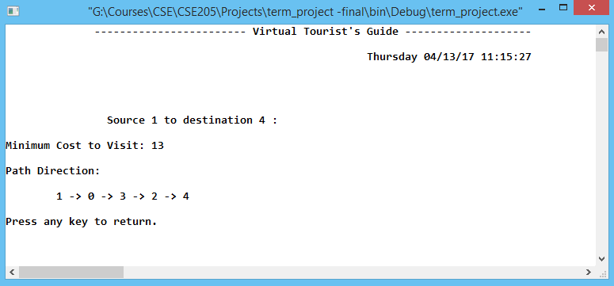

Algorithms and software description
Program Outputs:
Only Source fixed
Source and destination fixed

Slide 11
Thank You

